Slide 1
Problem Identification
Research Internship Project

Slide 2
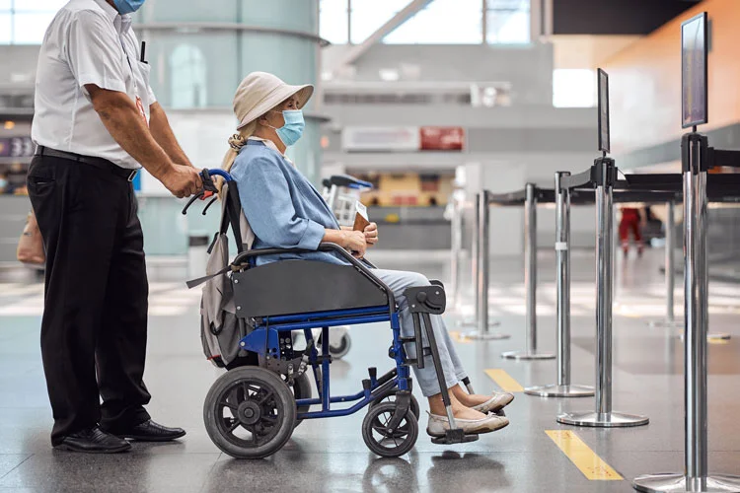
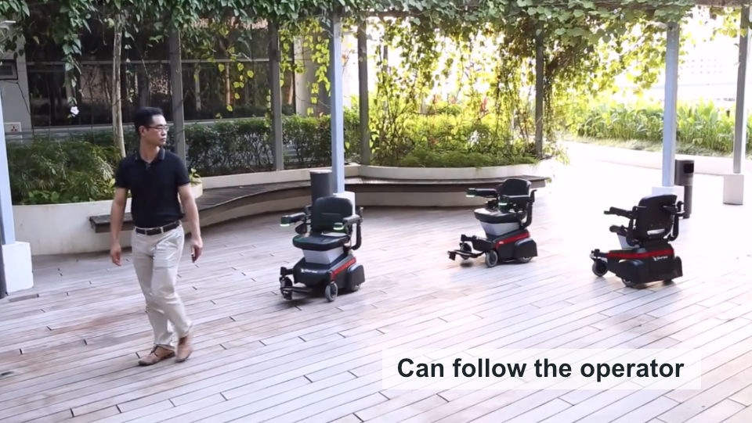
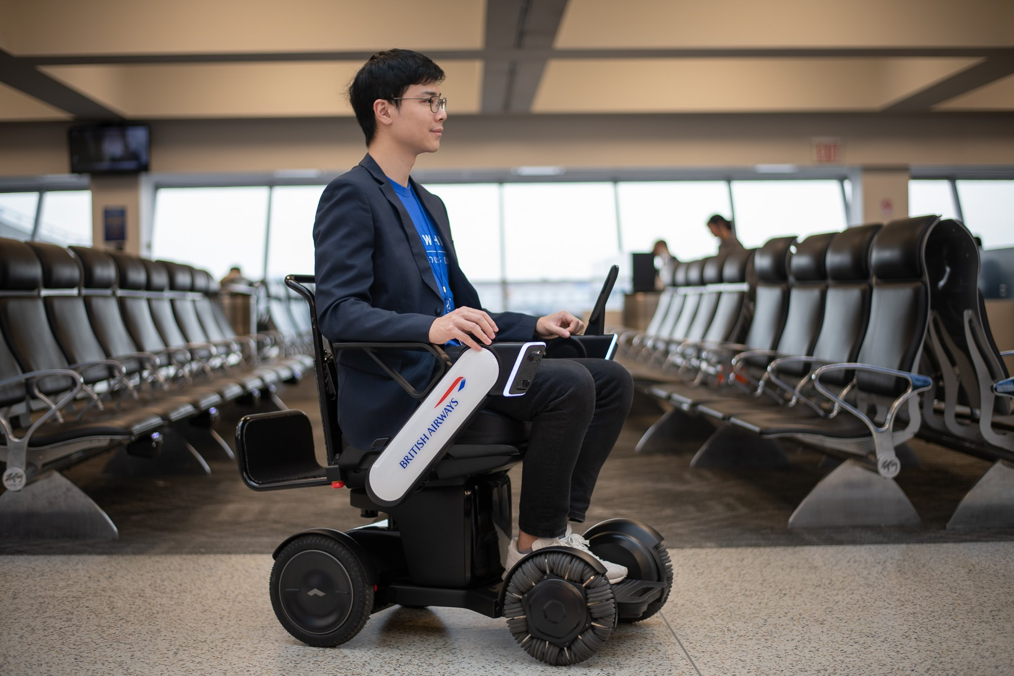
Transportation of people with reduced mobility at airports
Wheelchair with assistance from airline staff
Powered wheelchair navigated by airline staff
Automated wheelchair navigated by passenger

Slide 3
Drawbacks of Current Solutions
Difficulty in storage: Cannot be stacked. Most cannot be folded
Less flexibility in navigation: Cannot enjoy the whole experience provided by the airport
Assistance required for navigation inside airport, especially crowded ares
Cannot join other regular passengers

Slide 4
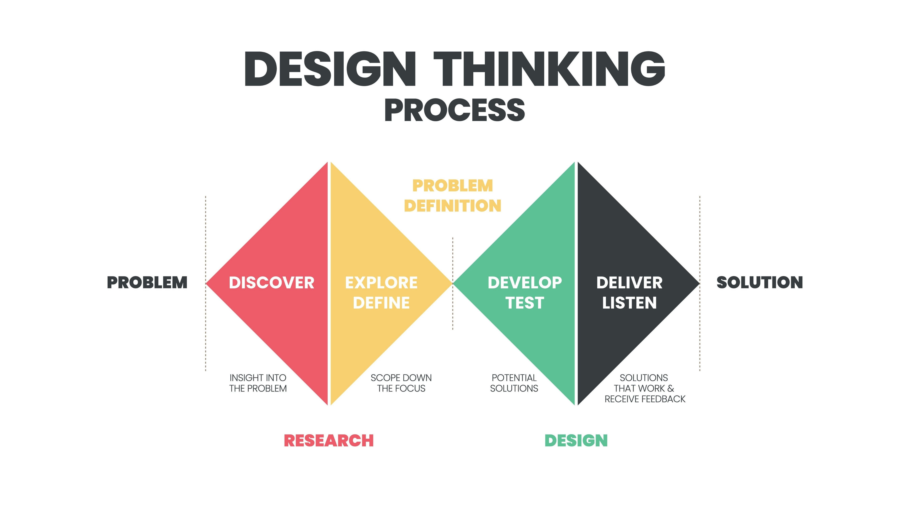

Slide 5
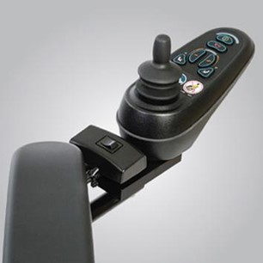
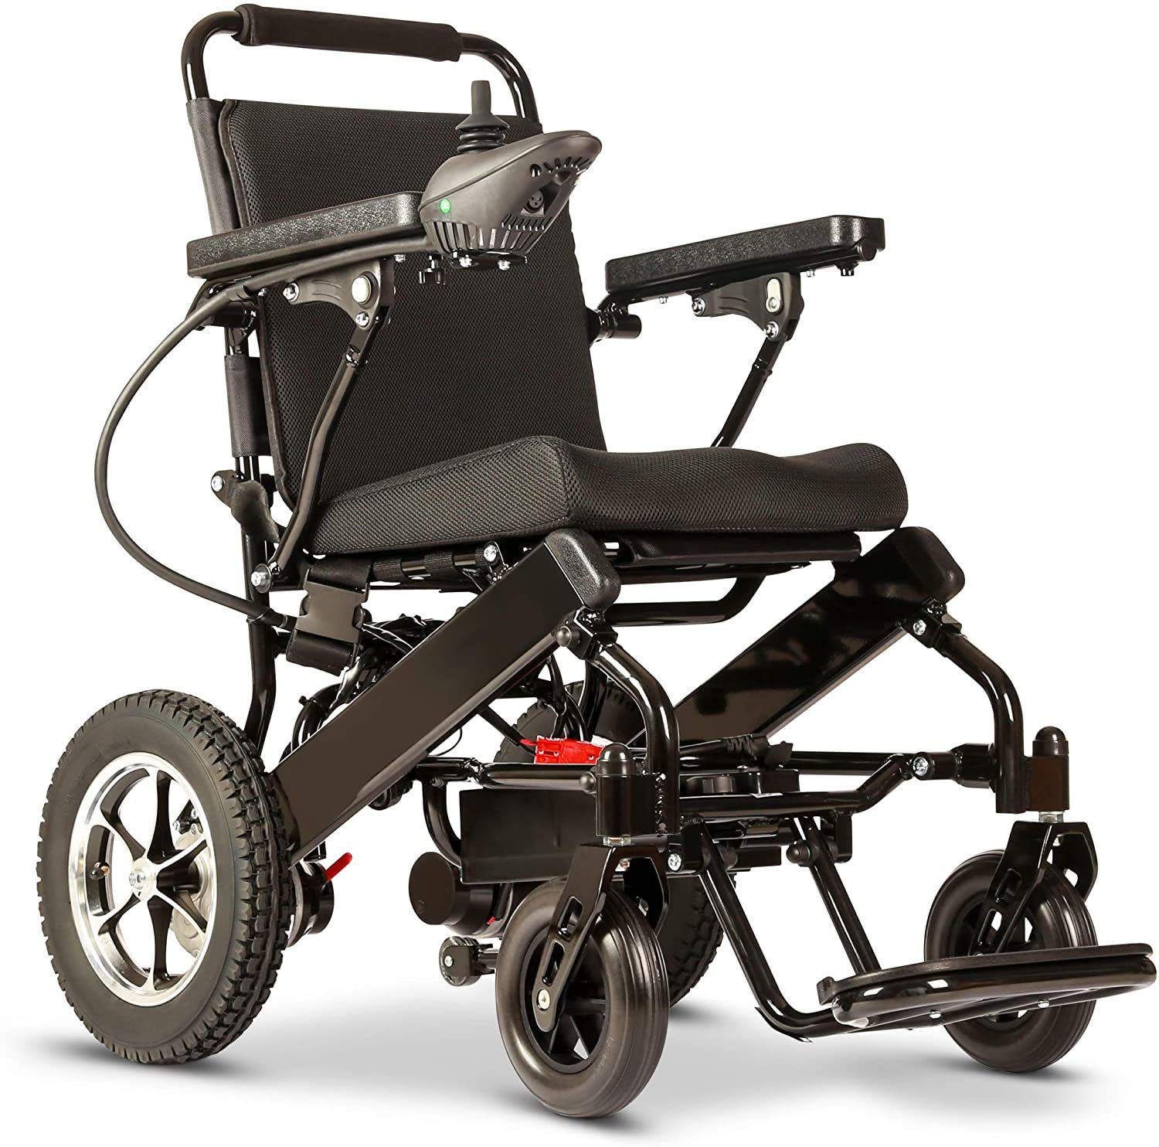
Possible Directions
User Experience Design: Control Panel design for self-service wheelchair passenger
Industrial Design: Design a new wheelchair identifying and solving problems with current designs

Slide 6
Thank you

